Slide 1
WHMIS 2015 Refresher Self Study for Non-Laboratory Staff
May 4, 2021
Environmental Health and Safety (EHS)

Slide 2
Before We Begin…
This course is for non-laboratory staff:
  Office, non-research staff, and supervisors in a research-intensive department
  Facilities management, maintenance, and caretaking staff
  Any non-lab employees who work with or near controlled hazardous product
  Must have previously completed WHMIS for Non-Lab Staff (EHS 576)
To meet regulatory requirements for refresher training, on an annual basis, workers can choose:
  Retake online training [retake WHMIS for Non-Lab Staff (EHS 576)]
  - Course registration and training records are on My EHS Training:
  https://ehs.utoronto.ca/training/my-ehs-training/;
  OR,
  - Complete this Self-Study (records are kept by the supervisor/unit and not by EHS)

Slide 3
Training Objectives
For every hazardous material that you work with, you should be able to:
Identify the hazards of the product
Know how to protect yourself from those hazards
Know what to do in an emergency
Know where to get more information

Slide 4
Key Components of WHMIS 2015
WHMIS 1988 was replaced by WHMIS 2015
WHMIS 2015 incorporates elements of GHS
- GHS is the Globally Harmonized System of Classification and Labelling of Chemicals
  Hazard identification and
  product classification
  Labelling
  Safety data sheets (SDSs)
  Training – general
  and specific*
Hazard ID and Product Classification
Labelling and Safety Data Sheets
WHMIS 2015
Worker Training and Education
*A specific training, or ‘hands-on’ training will
take place at your work area with a specific
material and will cover safe work routines and
emergency procedures associated with that material.

Slide 5
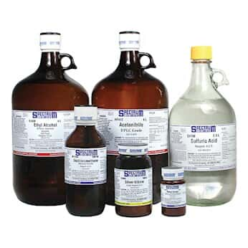
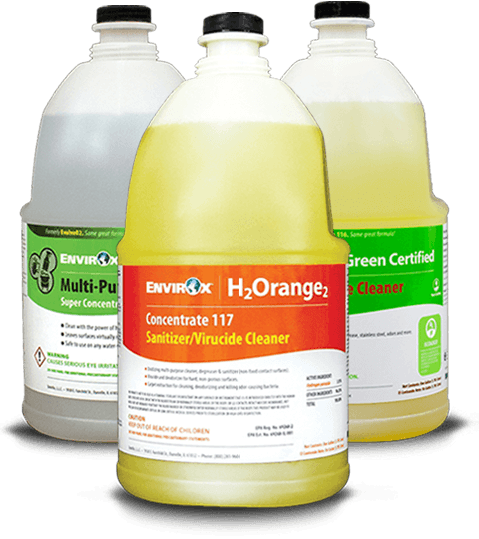
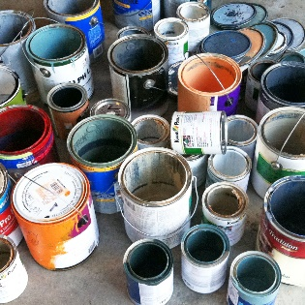
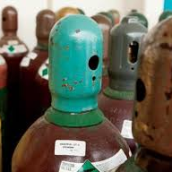
What are hazardous products?
A product that meets the criteria to be included in a hazard class or category under the Hazardous Products Act
Compressed
gases
Cleaning products
Organic and inorganic chemicals
Paints, fuels,
and solvents

Slide 6










WHMIS 2015 Pictograms
Exploding bomb
Explosion or reactivity hazards
Flame
Fire hazards
Flame over circle
Oxidizing hazards
Gas cylinder
Gases under
pressure
Corrosion
Corrosive damage to metal, skin, eyes
Skull and crossbones
Death or toxicity
with short exposure
to small amounts
Health Hazard
May cause or suspected of
causing serious health effects
Exclamation Mark
May cause less
serious health effects
Environment*
May cause damage
to the aquatic environment
Biohazardous infectious materials
Organisms or toxins that can cause diseases in people
or animals
* The environment pictogram is not required by WHMIS 2015 but may be used.

Slide 7
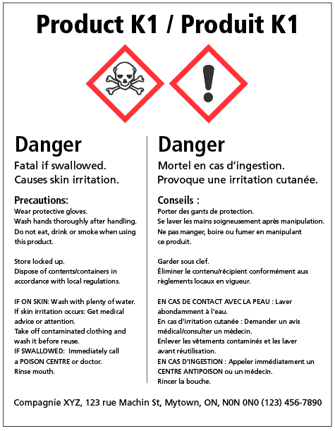
Supplier Labels (affixed by supplier)
1. Product identifier
Product name matching the SDS
2. Hazard pictograms
Graphics that alerts the reader to the type of hazard present
3. Signal words
“Danger” or “Warning” to emphasize hazards and indicate its severity
4. Hazard Statements
Standardized statements describing most significant hazards of the product
5. Precautionary Statements
Measures to take to minimize or prevent adverse effects from exposure to product
6. Supplier Identification
Company responsible for the label and
SDS
1
2
3
4
5
6

Slide 8
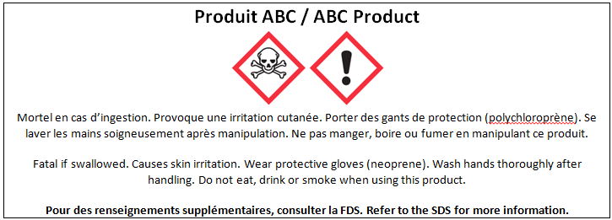
Workplace Labels
Workplace labels are required to be on the container of a hazardous products when a hazardous product is:
Created and used in the workplace
Transferred into another container
A supplier label is missing or becomes illegible
1
2
3
5
1. Product identifier
Product name matching the SDS
2. Safe handling precautions
Measures to minimize or prevent adverse effects from exposure to product. May include pictograms
3. Reference to SDS
Statement that the SDS is available

Slide 9
WHMIS 2015 Safety Data Sheets (SDS)
The SDS provides more detailed hazard information about the product than the label
The SDS tells users about:
- What the hazards of the product are
- How to use the product safely
- How to recognize symptoms of exposure
- What to do if emergencies occur
The SDS follows a standard
16-section format with specific
information requirements

Slide 10
WHMIS 2015 Safety Data Sheets (SDS)
16 Sections of an SDS
1. Identification | 9. Physical and Chemical properties
2. Hazard Identification | 10. Stability and Reactivity
3. Composition / Ingredient Information | 11. Toxicological Information
4. First Aid Measures | 12. Ecological Information
5. Fire Fighting Measures | 13. Disposal Considerations
6. Accidental Release Measures | 14. Transport Information
7. Handling and Storage | 15. Regulatory Information
8. Exposure Controls / Personal Protection | 16. Other Information
Section 4 outlines first aid measures in the event of an exposure to the hazardous product.

Slide 11
Exercises/Resources
To complete this refresher, workers and supervisors must complete:
  Two (2) Work Area Exercises
  Or
  Two (2) Standard Quiz Questions
  These exercises are reviewed by the supervisor (or designated) and records are kept by the unit/division (not EHS).
For more information on WHMIS:
Canadian Centre for Occupational Health and Safety (CCOHS): https://www.ccohs.ca/
Information on WHMIS 2015
WHMIS 2015 – Pictograms
WHMIS 2015 – Labels

